Slide 1
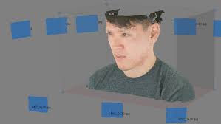
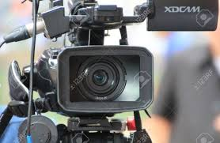
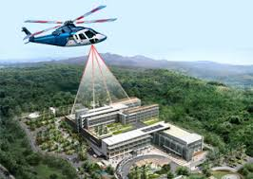
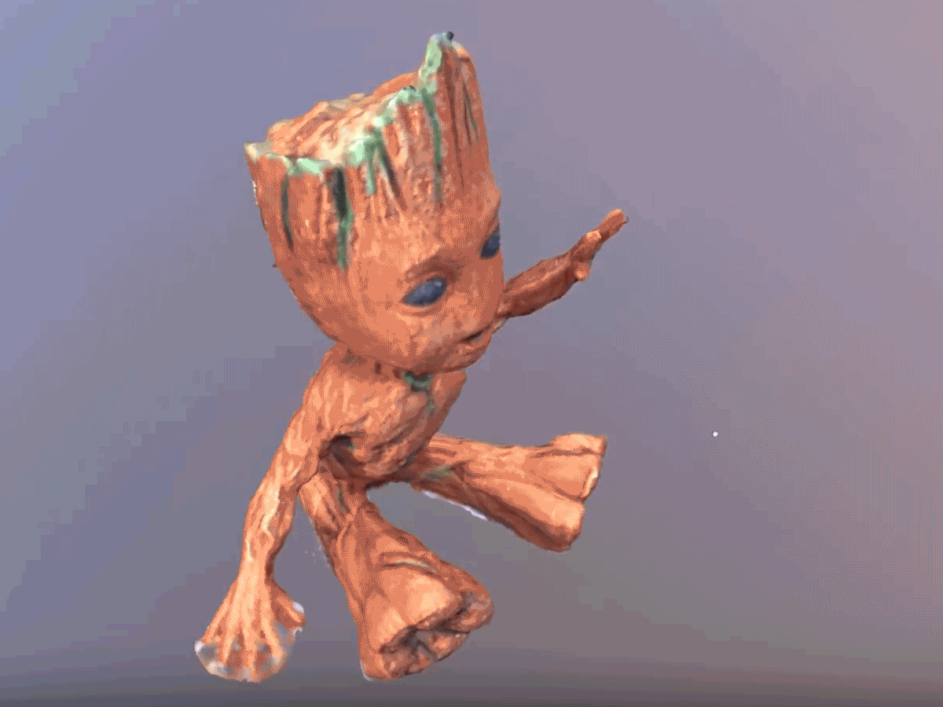
Introduction to Photogrammetry

Slide 2
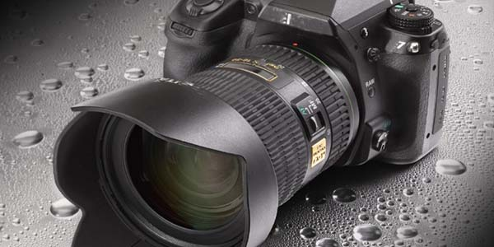
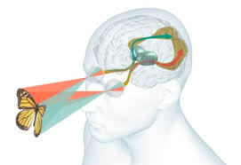
CONTENT
I. What is Photogrammetry
II. Principles of Human Vision
III. Branches of Photogrammetry
IV. Principles of Photogrammetry

Slide 3

Etymology of photogrammetry
Etymologically, the term photogrammetry is composed of three Greek roots : ‘Photo’, ‘Gram’ and ‘Metry’.
Hence, we can deduce the etymological meaning as ‘the science of measuring from photographs

Slide 4
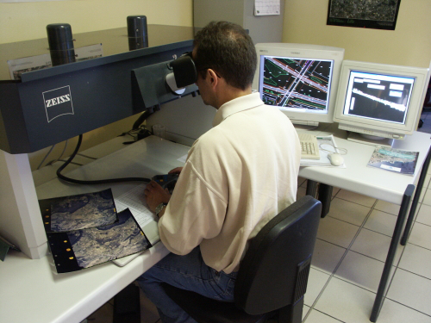
WHAT IT IS?
The American Society of Photogrammetry and Remote Sensing (ASPRS) defines photogrammetry as ‘the science, art and techniques of obtaining reliable information about physical objects and the environment through photographs.
This is done through a process of recording, measuring, and interpreting aerial and terrestrial photographs.

Slide 5
Photogrammetry Workflow
A standard workflow of Photogrammetry contains three main phases which are:
1) Data Acquisition,
2) Photogrammetric Procedures and
3) Photogrammetric Products.

Slide 6
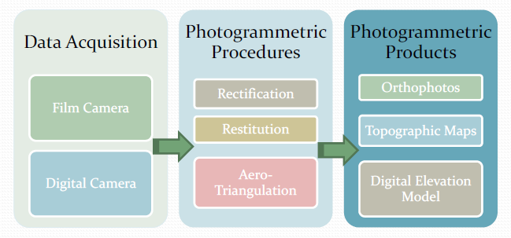

Slide 7
Branches of Photogrammetry
There are many methods used in photogrammetry in order to extract information from photos. However, Photogrammetry may be divided into two main groups
1) Aerial Photogrammetry
2)Close range (or Terrestrial) Photogrammetry.

Slide 8

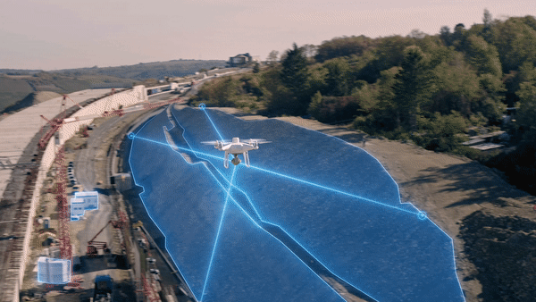
Aerial Photogrammetry

Slide 9
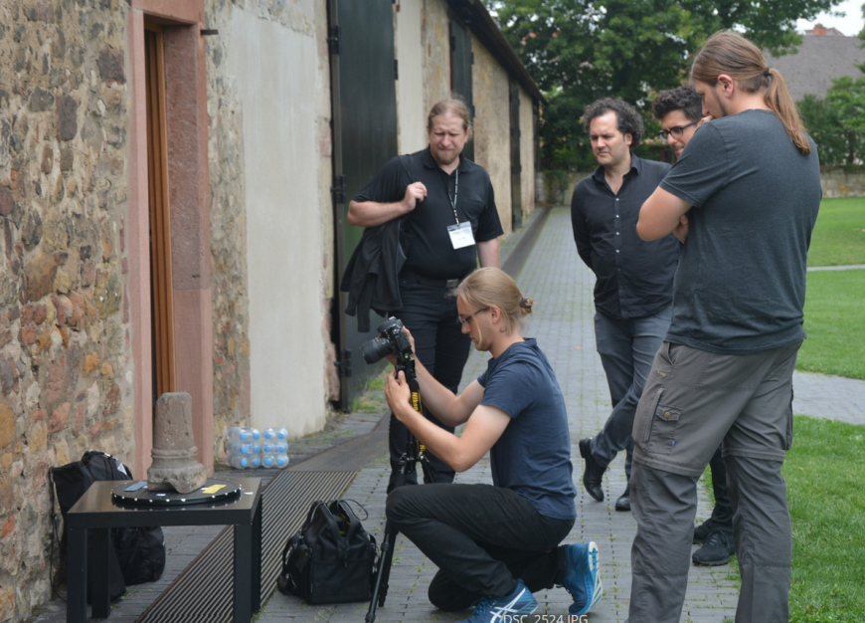
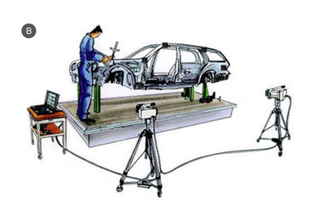
Close–range Photogrammetry

Slide 10
ADVANTAGES OF PHOTOGRAMMETRY
The foremost advantage of photogrammetry is the ease and speed at which the data can be collected
the photogrammetric techniques yield results that are highly accurate making it very reliable to use for mapping or other purposes
It offers a wide or broad view of the mapped area by utilizing both topographic and cultural features of the land surface.

Slide 11
The data that is collected is permanent .
Due to the fact that the information collected is permanent, it is much easier to re-survey or re-evaluate the site again to get any of the missing information without the loss of any time.
With the use of UAV or satellite imagery photogrammetry it is easy to take photos of remote areas and hard to reach locations with accuracy in dimensions.

Slide 12
DIS -ADVANTAGES OF PHOTOGRAMMETRY
The major disadvantage is that the photogrammetric survey is not possible in the absence of light.
visibility constraints in the area which can be caused by seasonal occurrences like snowfall or rainfall.
The accuracy of the measurements depends highly on the flight height and skilled restitution.
The digital aspect of the photogrammetry surveys makes it susceptible to hacks and loss of data due to viruses.

Slide 13
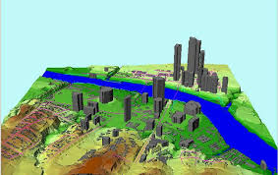
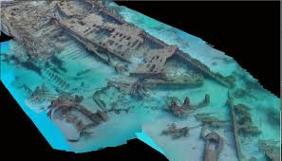
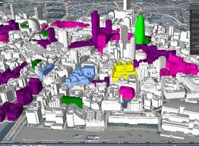
applications of photogrammetry
1.CIVIL ENGINEERING
Mapping:
Geology
Archaeology

Slide 14
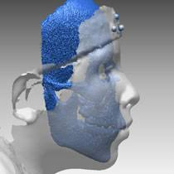
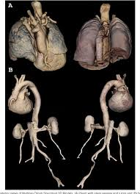
2.Medicine

Slide 15

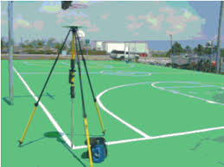
3. Sports-Sports like biking, climbing, trekking, cross country rallies all depend on the accuracy of the terrain maps.

Slide 16



4.Film making and entertainment:

Slide 17
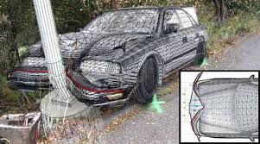

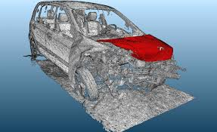
5. Forensics:

